Slide 1

Customer churn analysis

Slide 2
Business problem: increasing customer churn due to high competition.
Objective: to build a model that can predict whether customers will churn or not churn and to analyze the possible reasons for customers to churn.

Slide 3
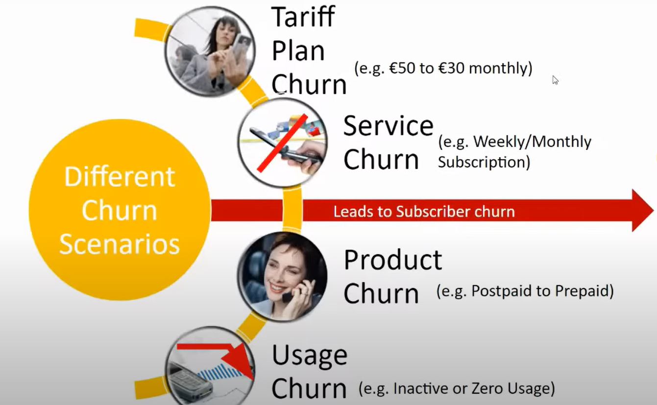

Slide 4
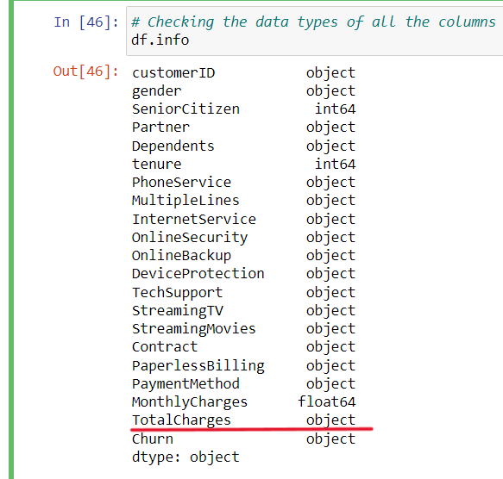
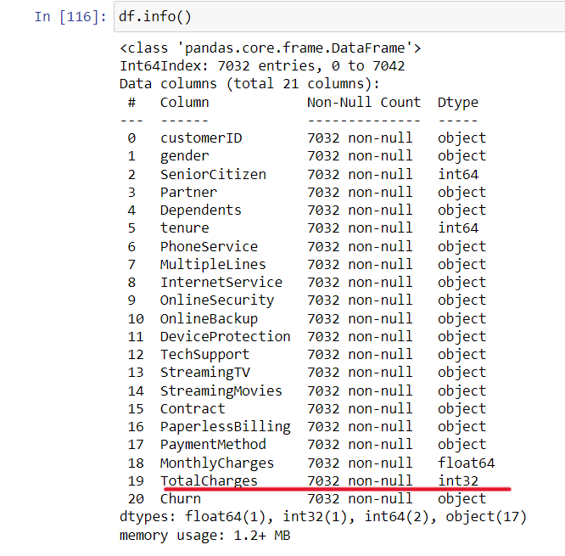
Data cleaning & manipulation:

Slide 5
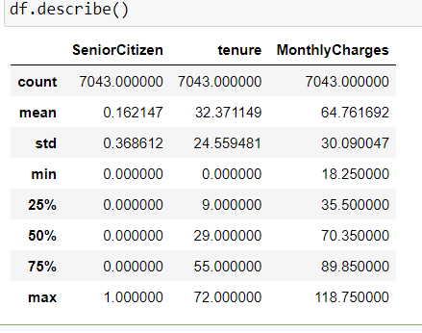
Descriptive statistics of numerical variables
75% of customers have tenure of less than 55 months
Average Monthly charges are USD 64.76 whereas 25% of customers pay more than USD 89.85 per month

Slide 6
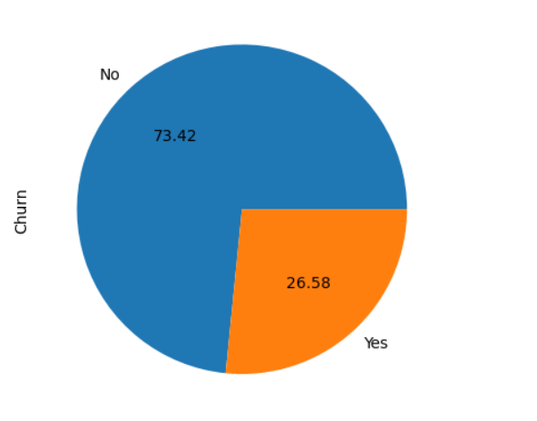
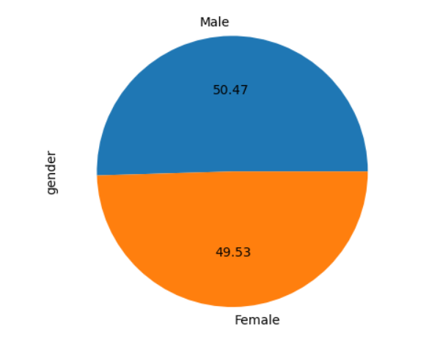
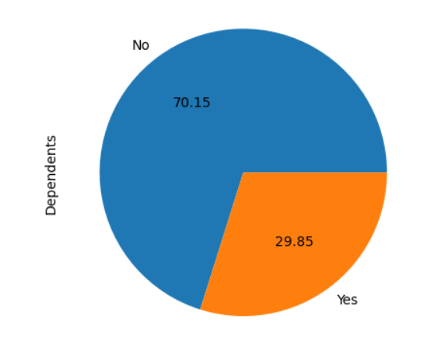
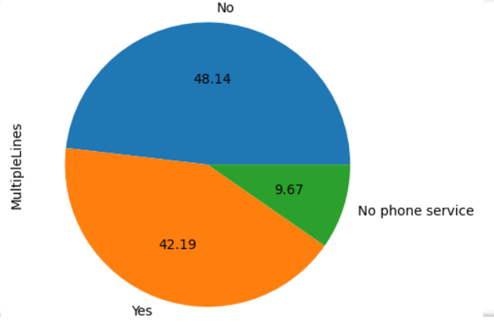
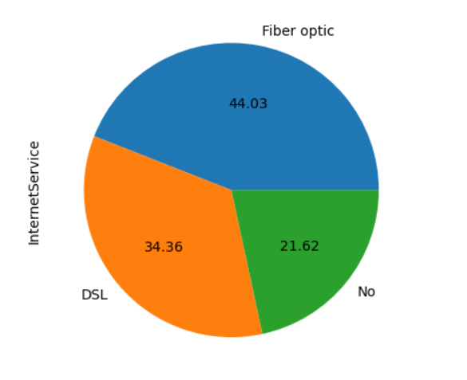
Univariate analysis:

Slide 7
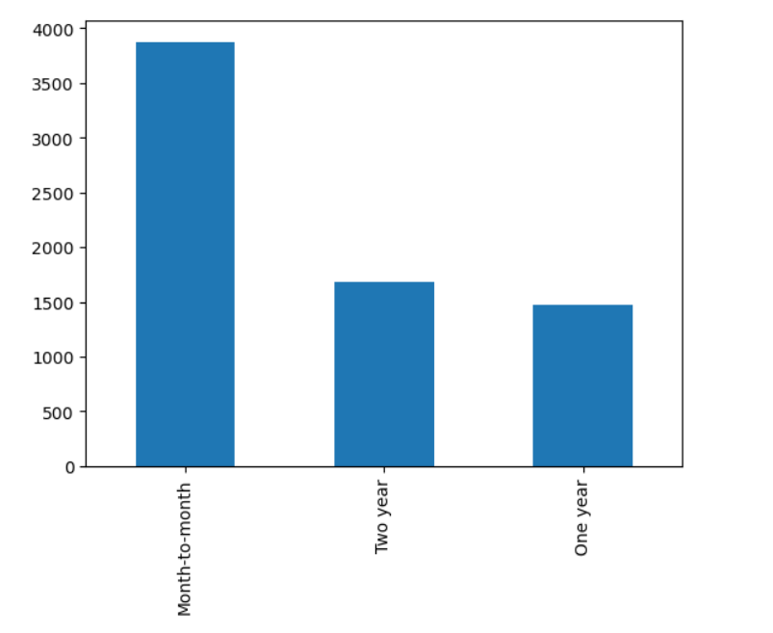
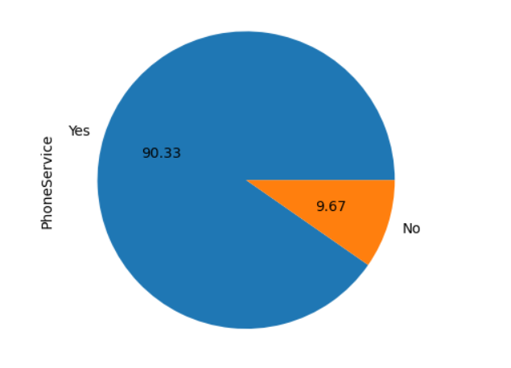
- no. of customers who have a month-to-month contract is higher
- 90% of customers have phone Service.

Slide 8
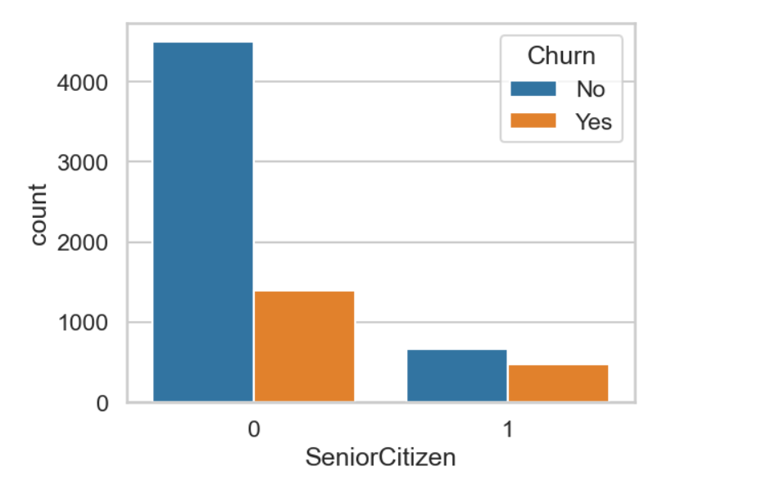
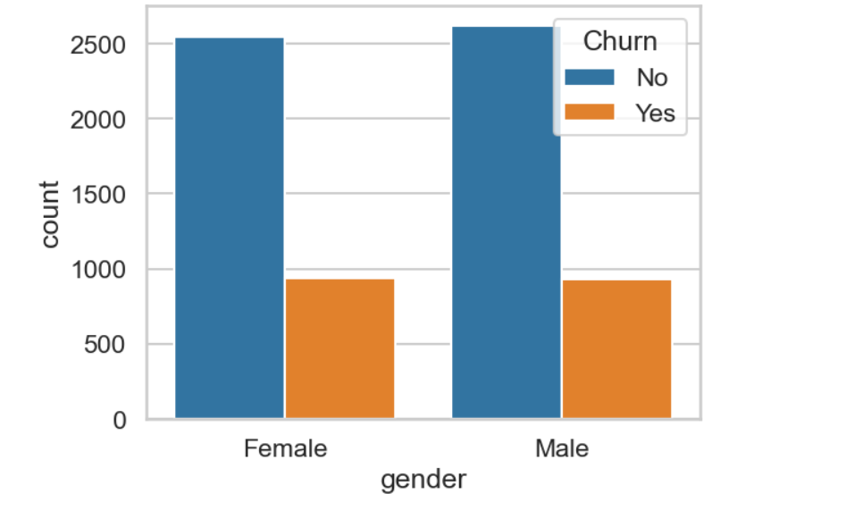
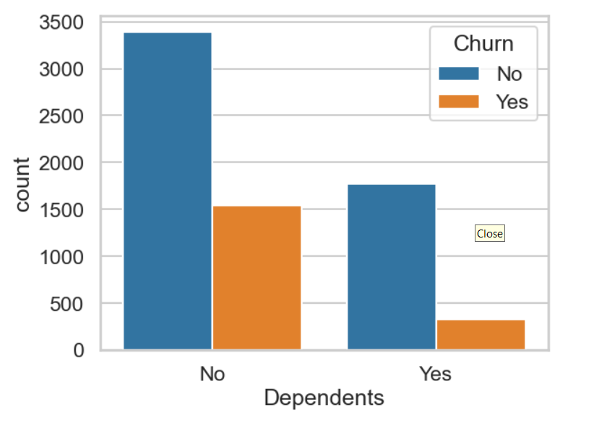
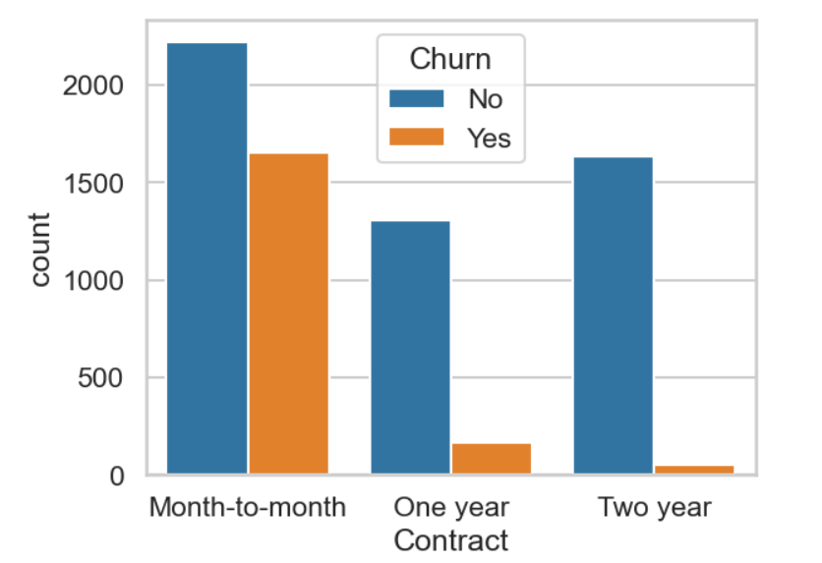
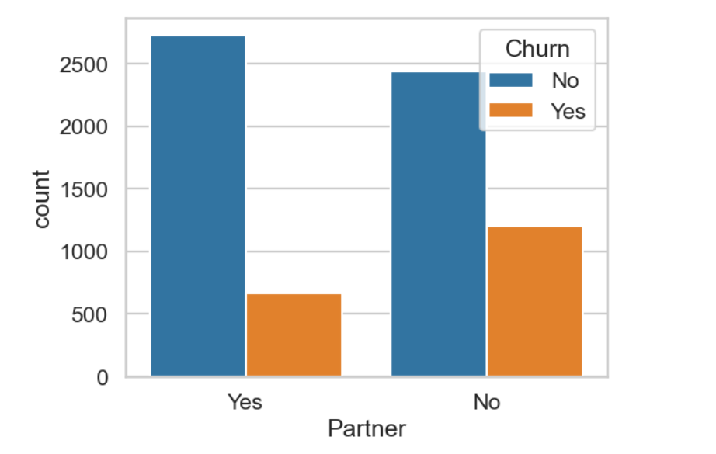
Bi variate analysis:

Slide 9
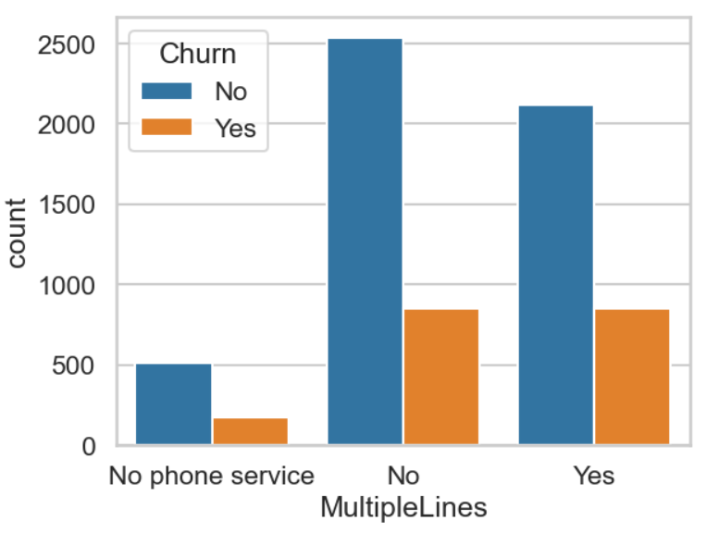
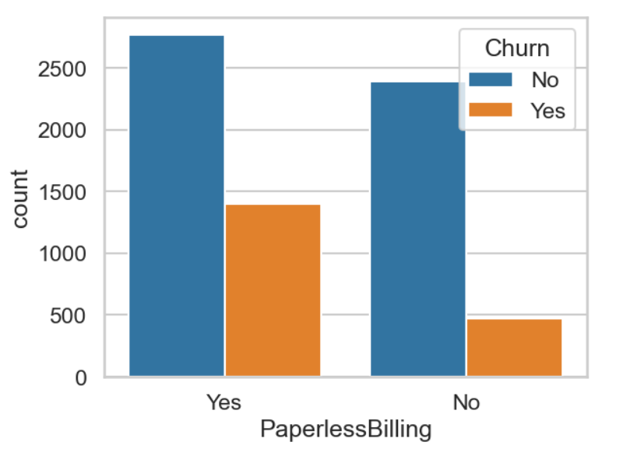
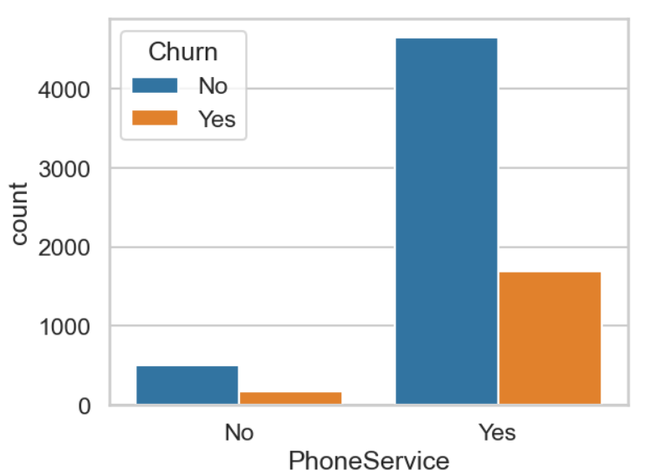
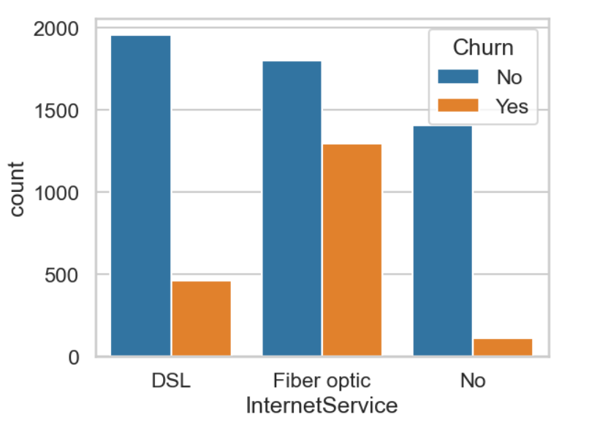
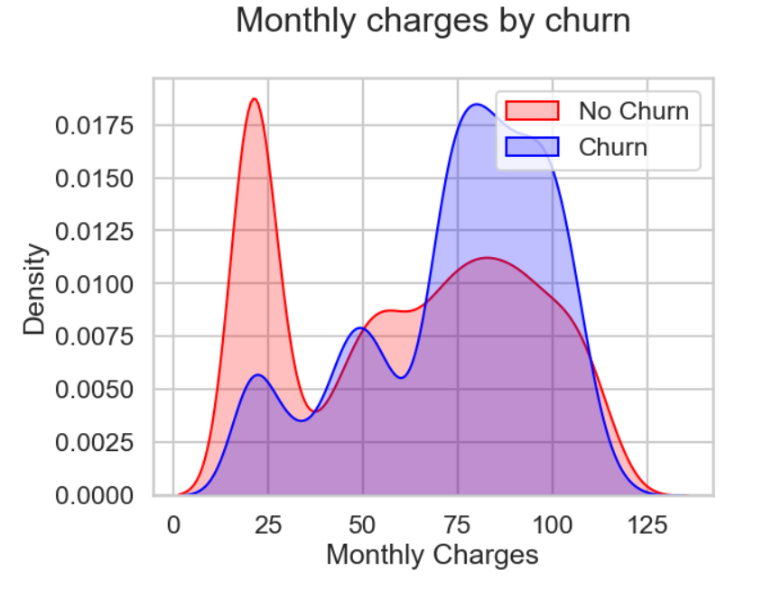

Slide 10
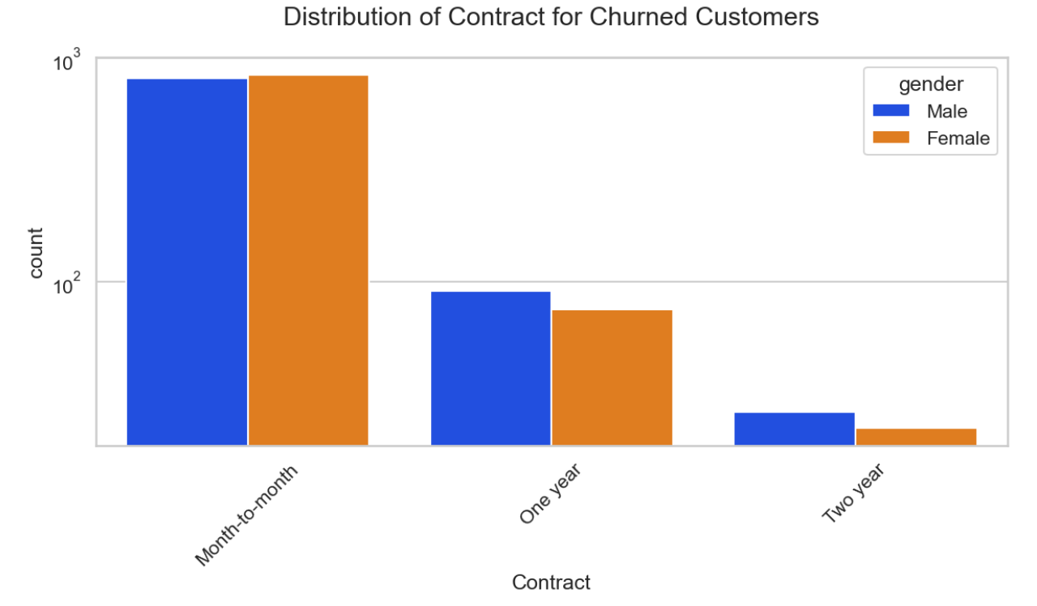
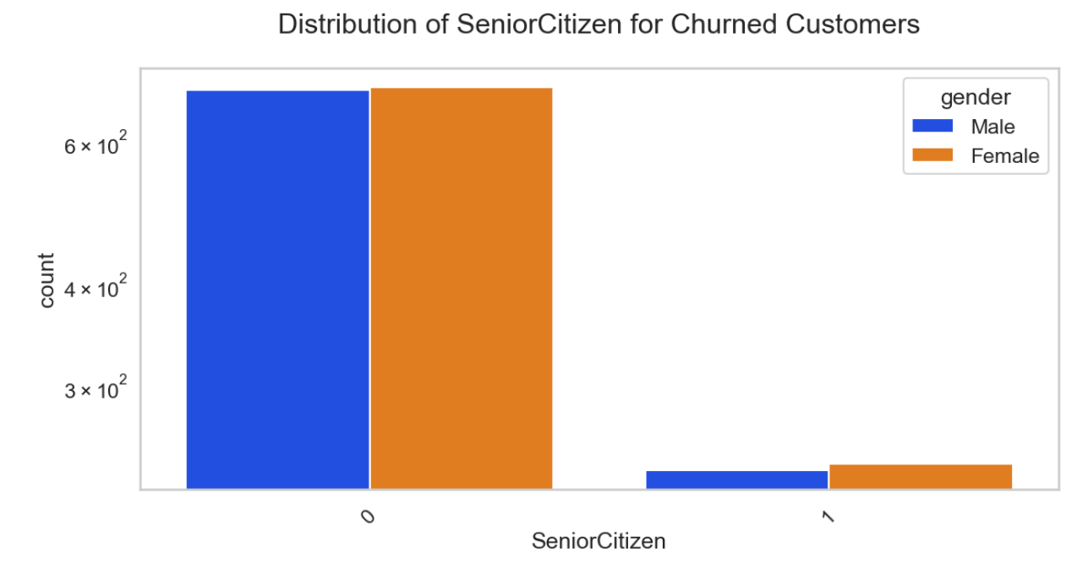
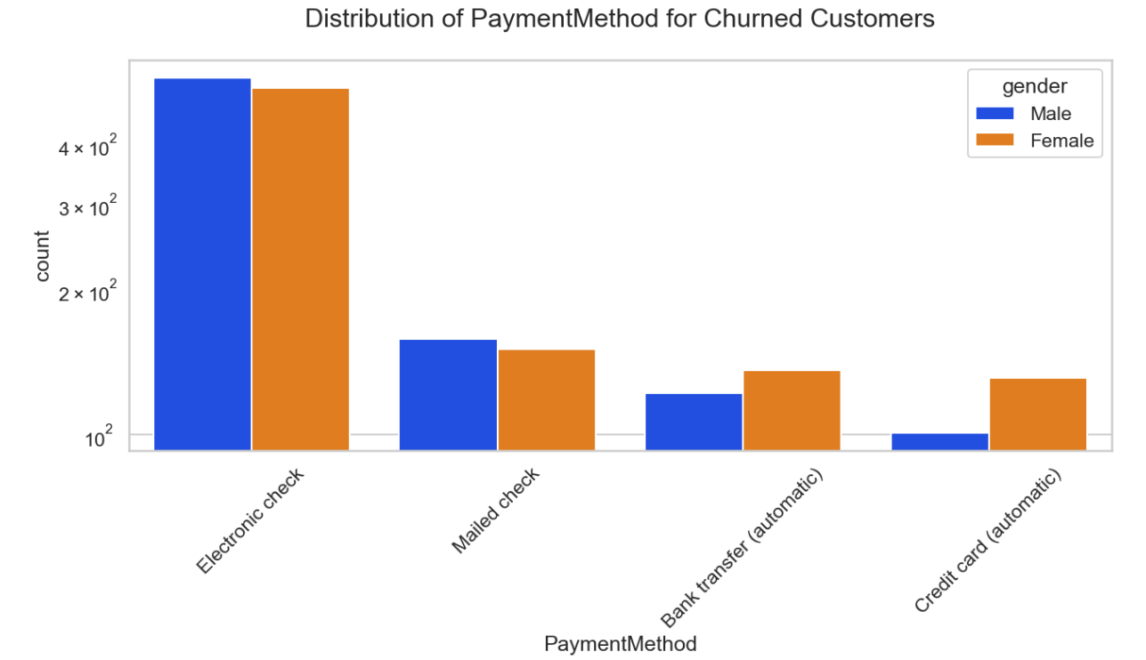
Multivariate analysis:

Slide 11
Derived Insights:
HIGH Churn seen in the case of Month-to-month contracts, No online security, No Tech support, First year of subscription, and Fibre Optics Internet.
LOW Churn is seen in the case of long-term contracts, Subscriptions without internet service, and customers engaged for 5+ years.
Factors like Gender, Availability of phone service and # of multiple lines have almost NO impact on Churn.
Electronic check mediums are the highest churners.
Contract Type - Monthly customers are more likely to churn because of no contract terms, as they are free-to-go customers.
No Online security, No Tech Support category are high churners.
Non-senior Citizens are high churners.

Slide 12
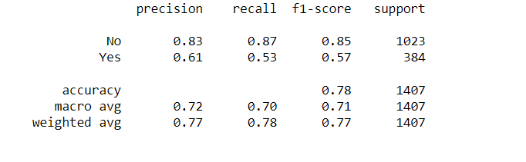
KNN Algorithm:

Slide 13
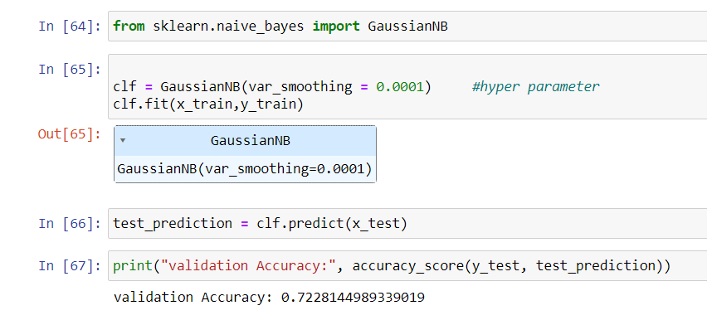
NAIVE BASE ALGORITHM

Slide 14
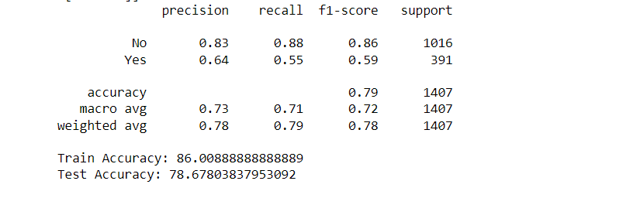
SVM ALGORITHM

Slide 15

THANK YOU

